Slide 1
S T
TEAM : WANDERERS
SURYA
THEODER
YUKESH
ROJA MUTHIAH
VISHWA
NAZIA
VERONICA
SOWRI RAJAN
RAGAV
RAHUL
ROYSTER

Slide 2
ABSTRACT
Making a digital ticket booking method for all passengers. Each and Every passenger should have DIGITAL card which will be used in booking tickets. Now onwards the passenger should not give cash to take the tickets just need to scan the QR code available in your personal card which will have all the details of passenger. Thus the ticket will be booked for your destination and received in SMS.

Slide 3
DISTADVANTGES in current method
Lot of time is invested in taking tickets while travelling in bus
We may face the problem of exchanging or unavailable of changes of coins with conductor
Usage of paper tickets and keeping it face with us
Carrying cash in bus also maybe unsafe sometimes
Lot many problems

Slide 4
SMOOTH TRAVELLING
DIGITAL CARD FOR BOOKING
TICKETS IN BUS

Slide 5
CONCEPT
First of all of Smooth travelling is a simple idea to ease the amount of time during travel
Here we are introducing a card called smooth travelling card which is a smart card to eliminate the use of cash and paper tickets
It is a rechargeable card
It is a smart card which contains passenger details
The booked ticket will appear as SMS
This would help us from waiting for changes(coins) in bus, everything will be in DIGITAL WAY

Slide 6
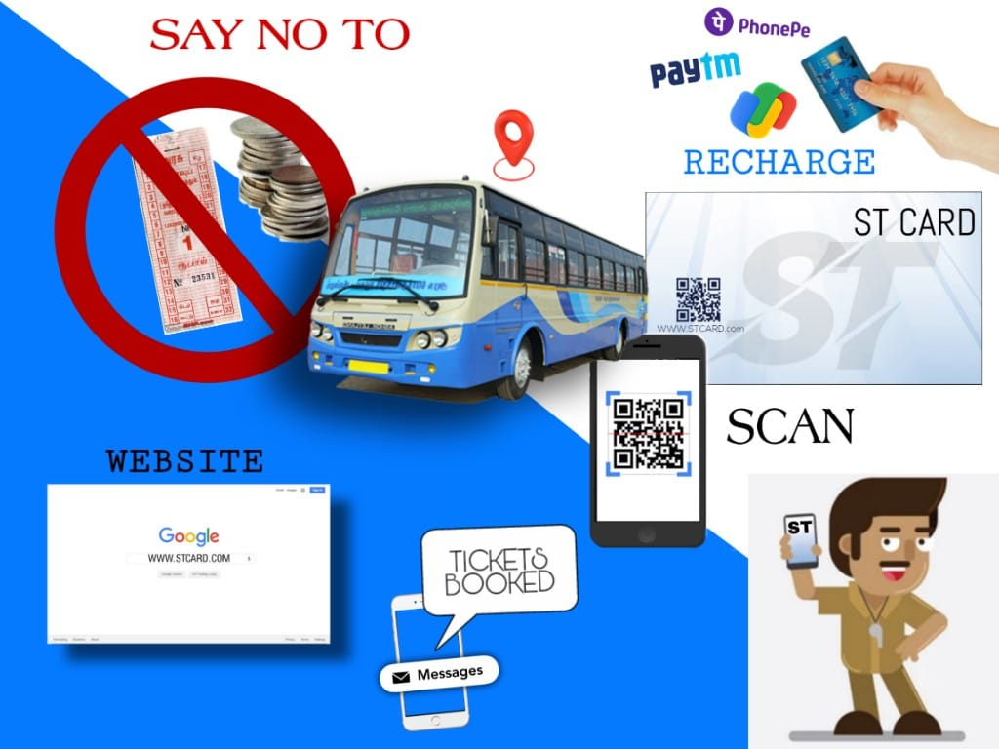

Slide 7
ADVANTAGES
By doing this we eliminate the receipt form….and the amount of work done by the conductor to distribute tickets to passenger will be reduced.
we can do cost cutting by reducing the use of printing papers.
We can eliminate the problem of exchanging coins
We can keep the records number of customers and tickets distributed in DIGITALLY
Thus this concept ensures smooth way of travelling for passenger and it significantly saves time for both the conductor and passenger

Slide 8
BENEFITS
TRANSPORTATION plays a major key role in the development of any economy
The state transportation corporations of Tamilnadu have a huge strength of buses to ensure safe travel across all the routes over Tamilnadu
By this concept we can improvise the way of travel which benefits both the passenger and the transportation department
This will help us to have the data of all passengers, This data may be used for many things.

Slide 9
REQURIMENTS
ST CARD
QR code scanner
Ticket booking PAGE
ST WEBSITE
sign in/up
LOGIN
Recharge
details of passenger

Slide 10
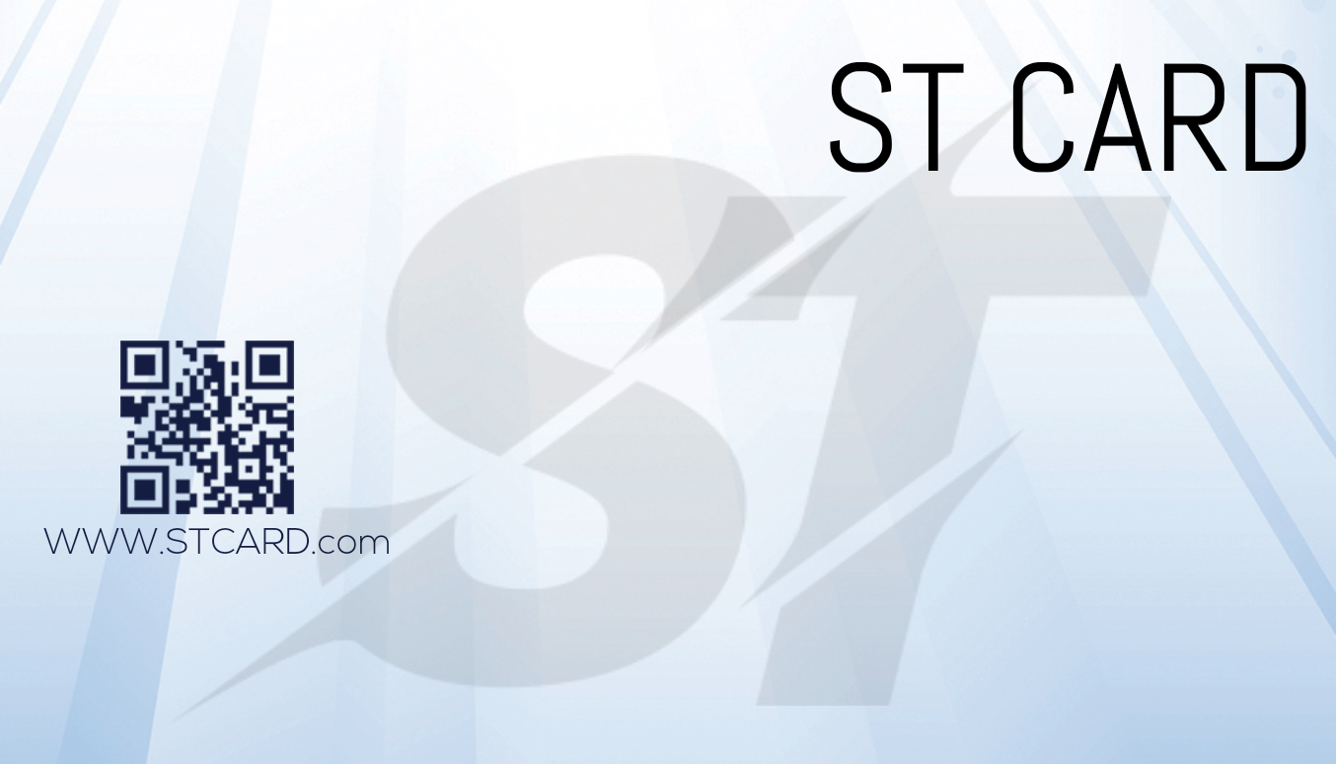

Slide 11
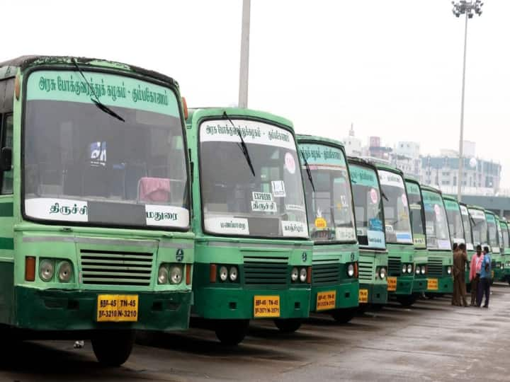
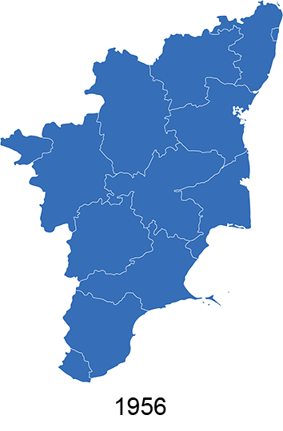
The state transportation corporations of Tamilnadu have a fleet strength of 21,744 buses including 2,254 spare buses

Slide 12
REAL TIME EXAMPLE
For eg we take tamilnadu bus route 19 starting from Kelambakkam and ending in Sathyabama Bus route distance is 13km
Stops
1.Chettinad Hospital
2.Hindustan ENGG College
3.Padur
4.Khazipattur
5.Sipcot

Slide 13
6.Navalur
7.AGS
8.Semmancheri
The passenger should show the ST CARD which will be having QR code with all details
The conductor will scan the code and enter the destination
So here bus fare for each is 27rs
So lets take a real life example suppose we need to take 5 tickets then the total fare is 135rs by using ST card of a individual we can pay at a single shot and the details will be thrown as a SMS to the passenger

Slide 14
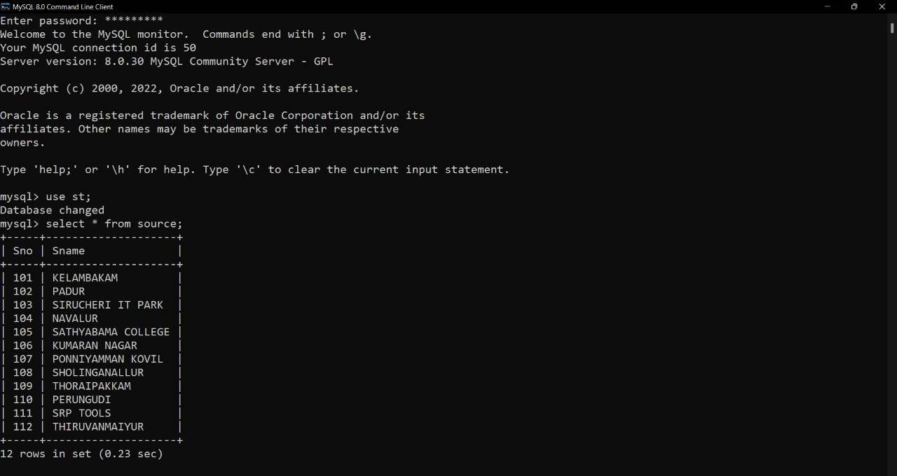

Slide 15
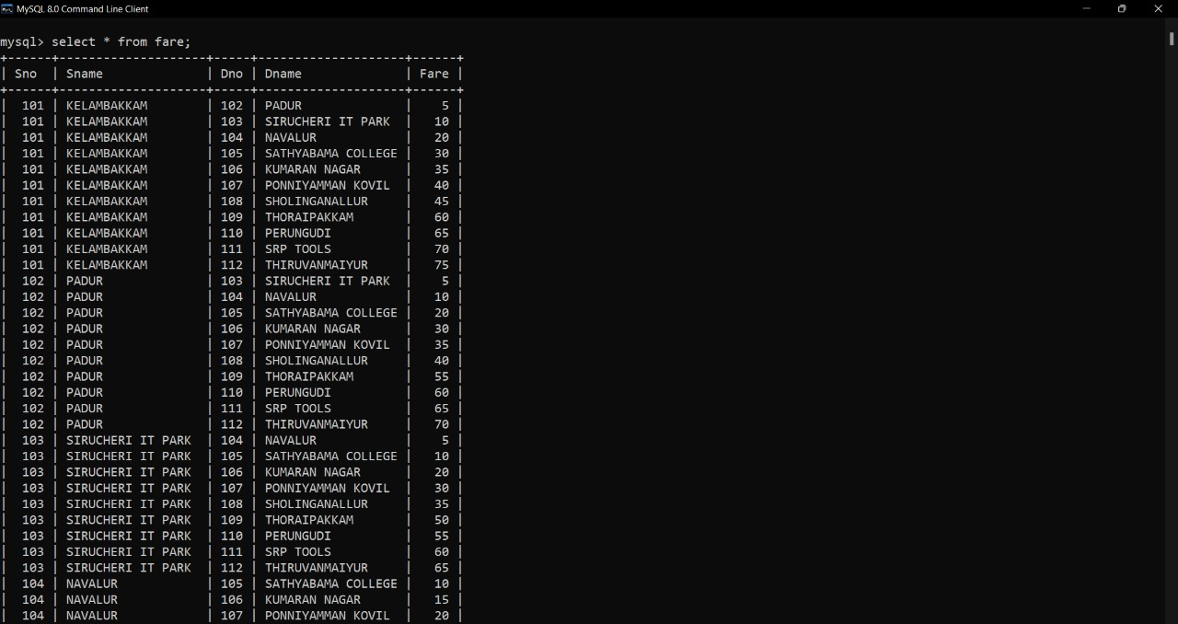

Slide 16
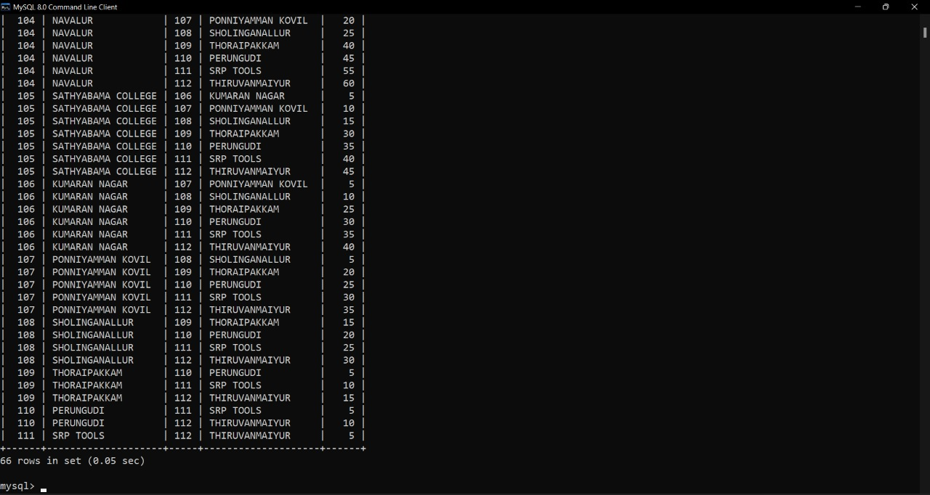

Slide 17
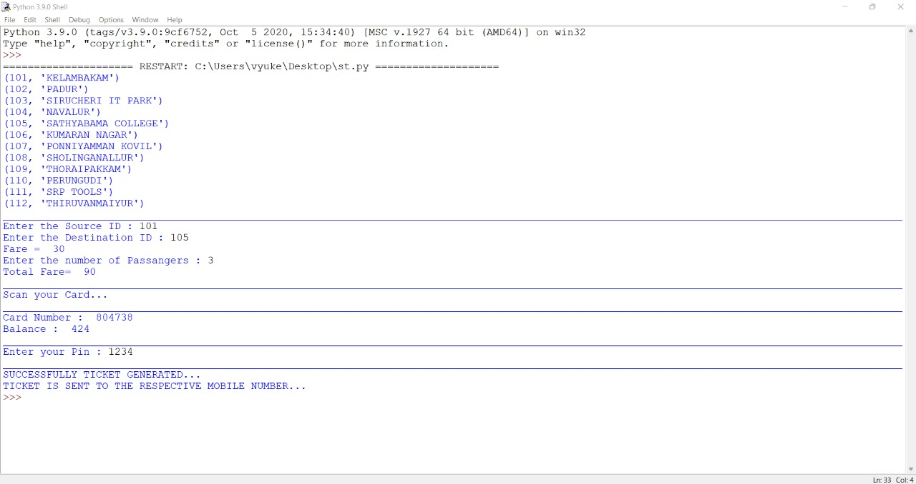

Slide 18

ST WEBSITE

Slide 19
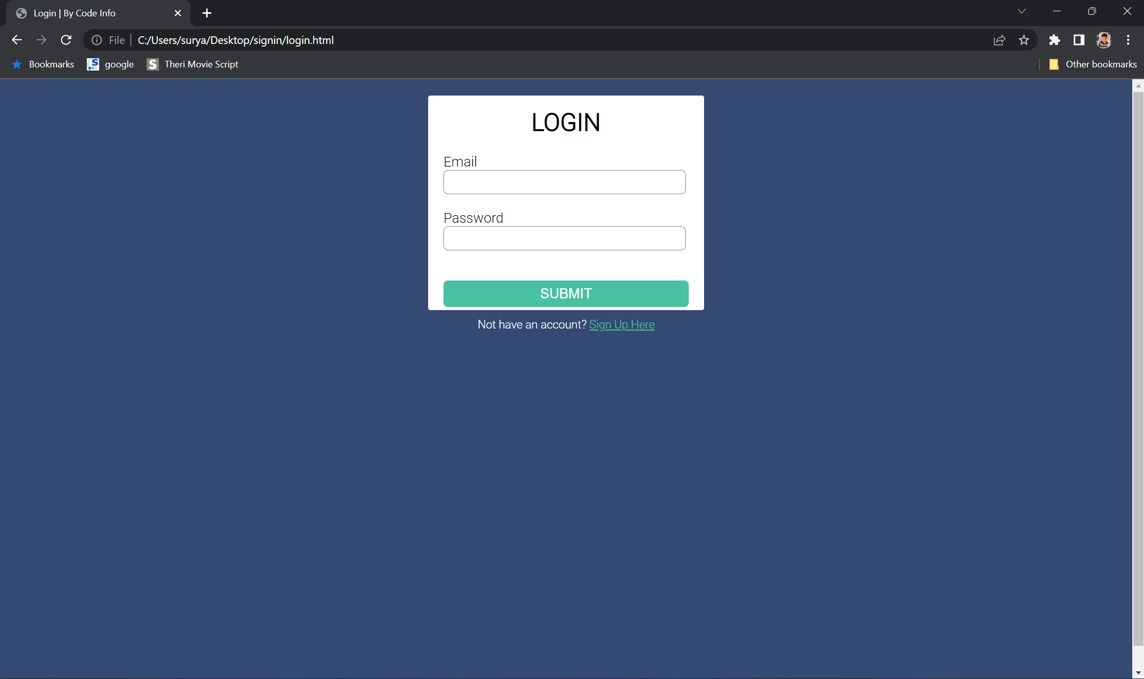

Slide 20
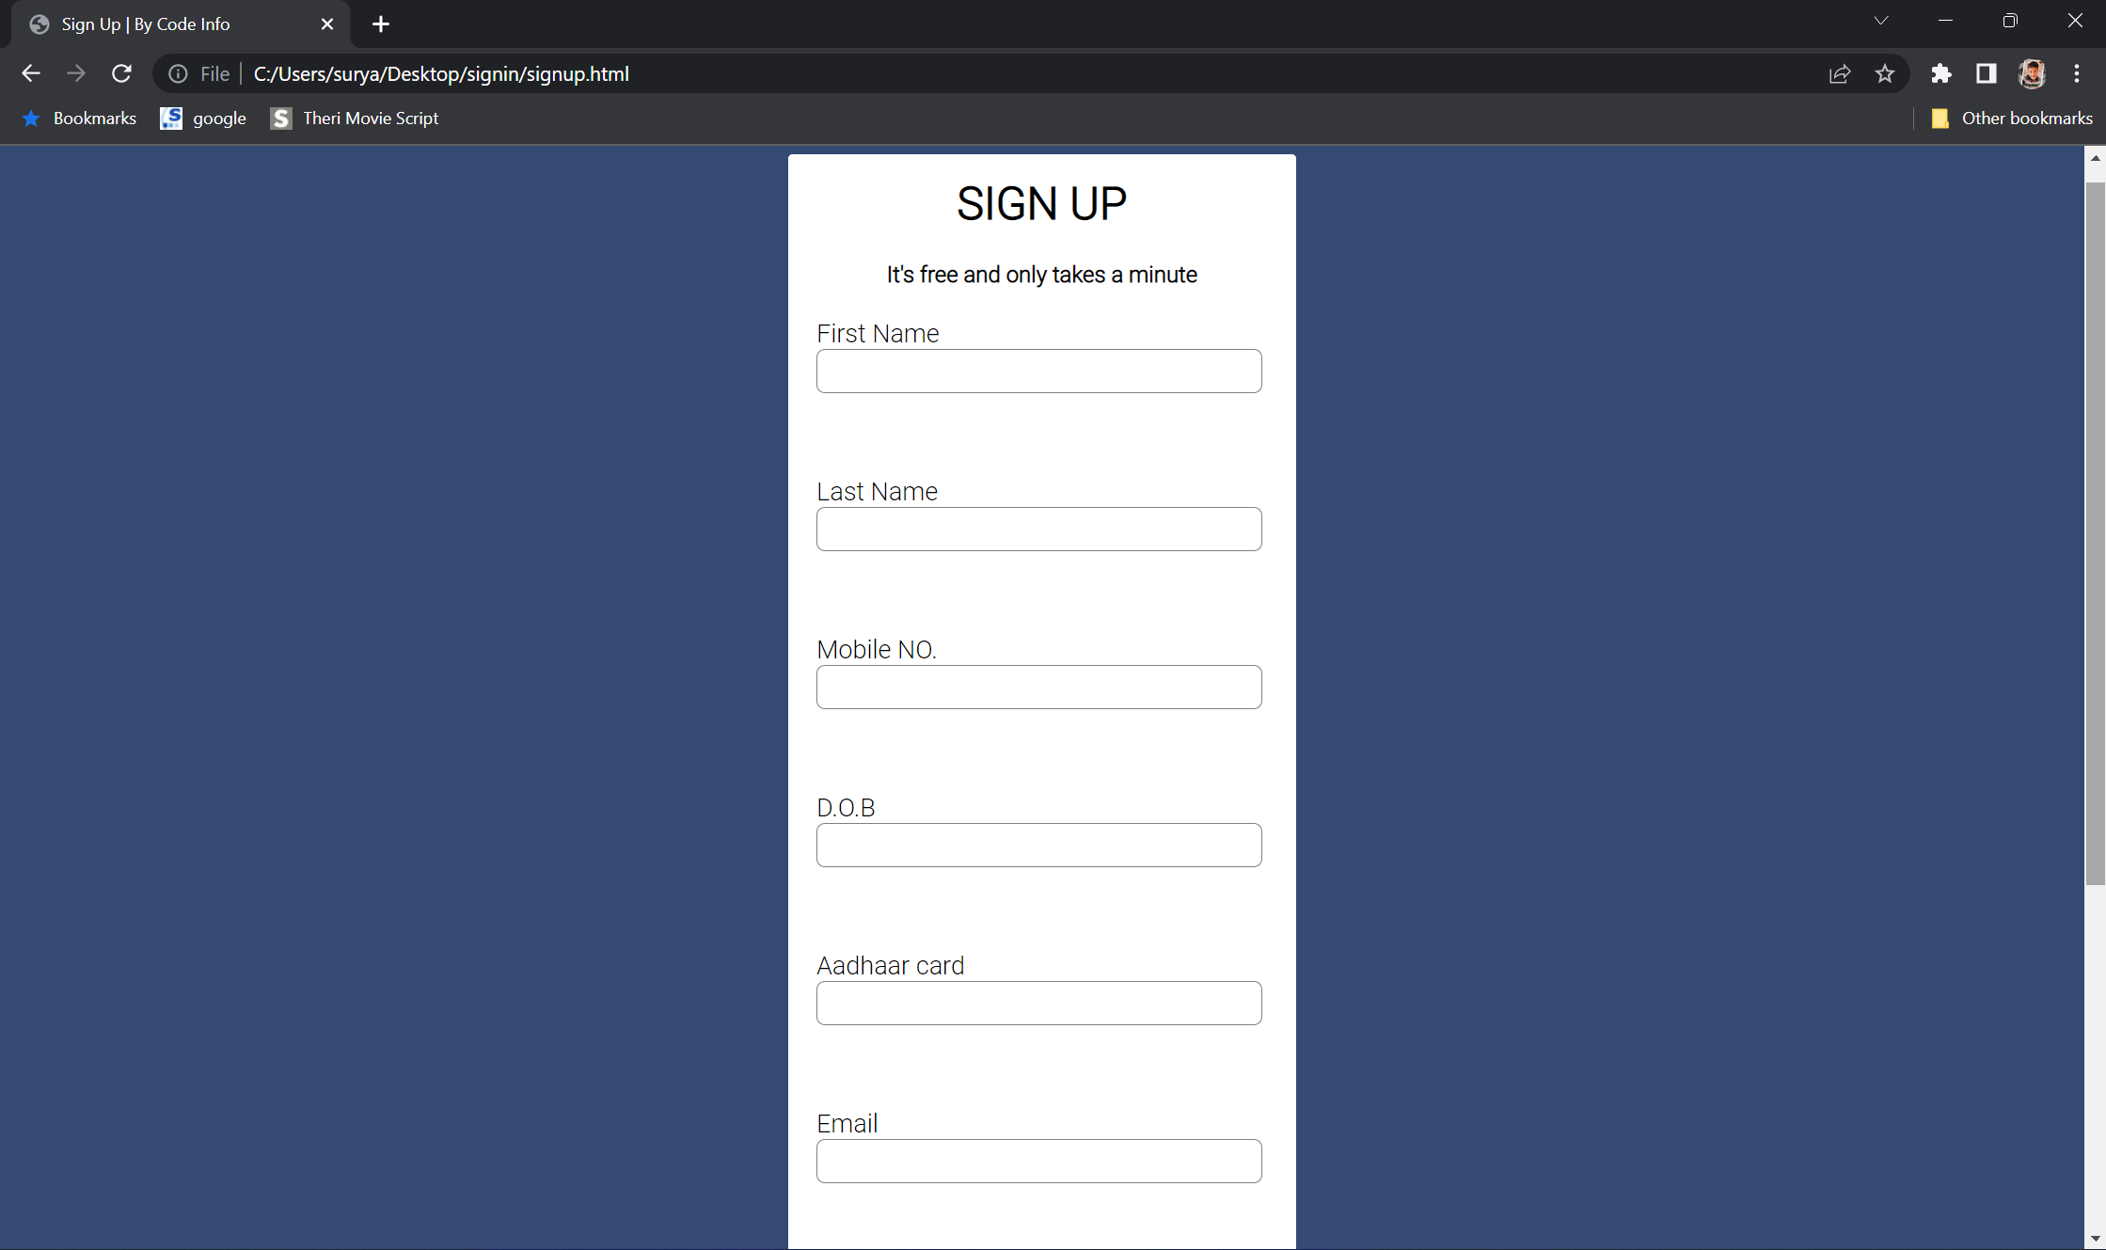

Slide 21
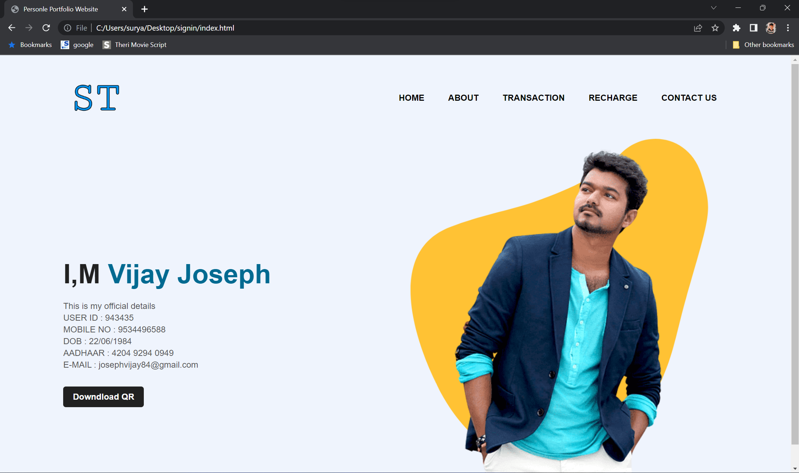

Slide 22
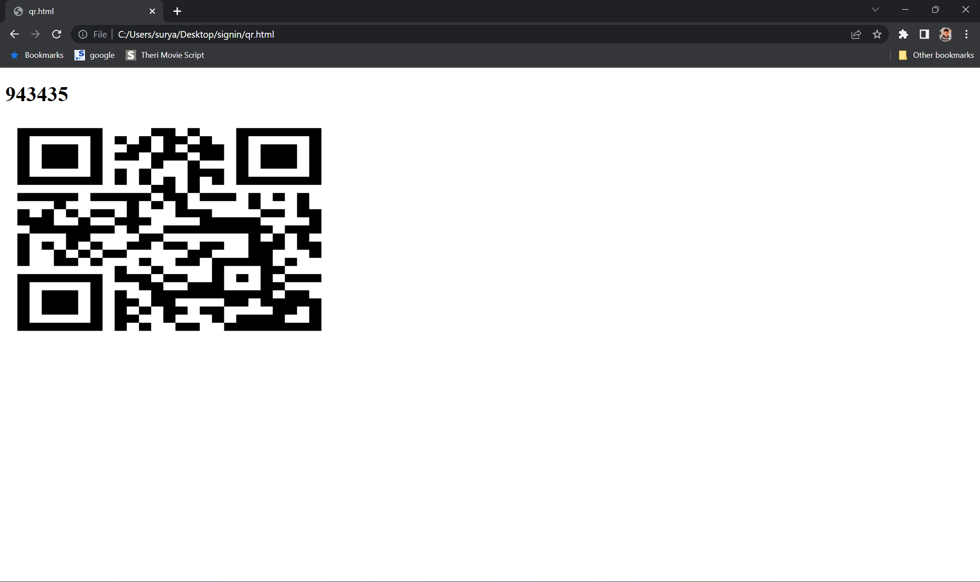

Slide 23
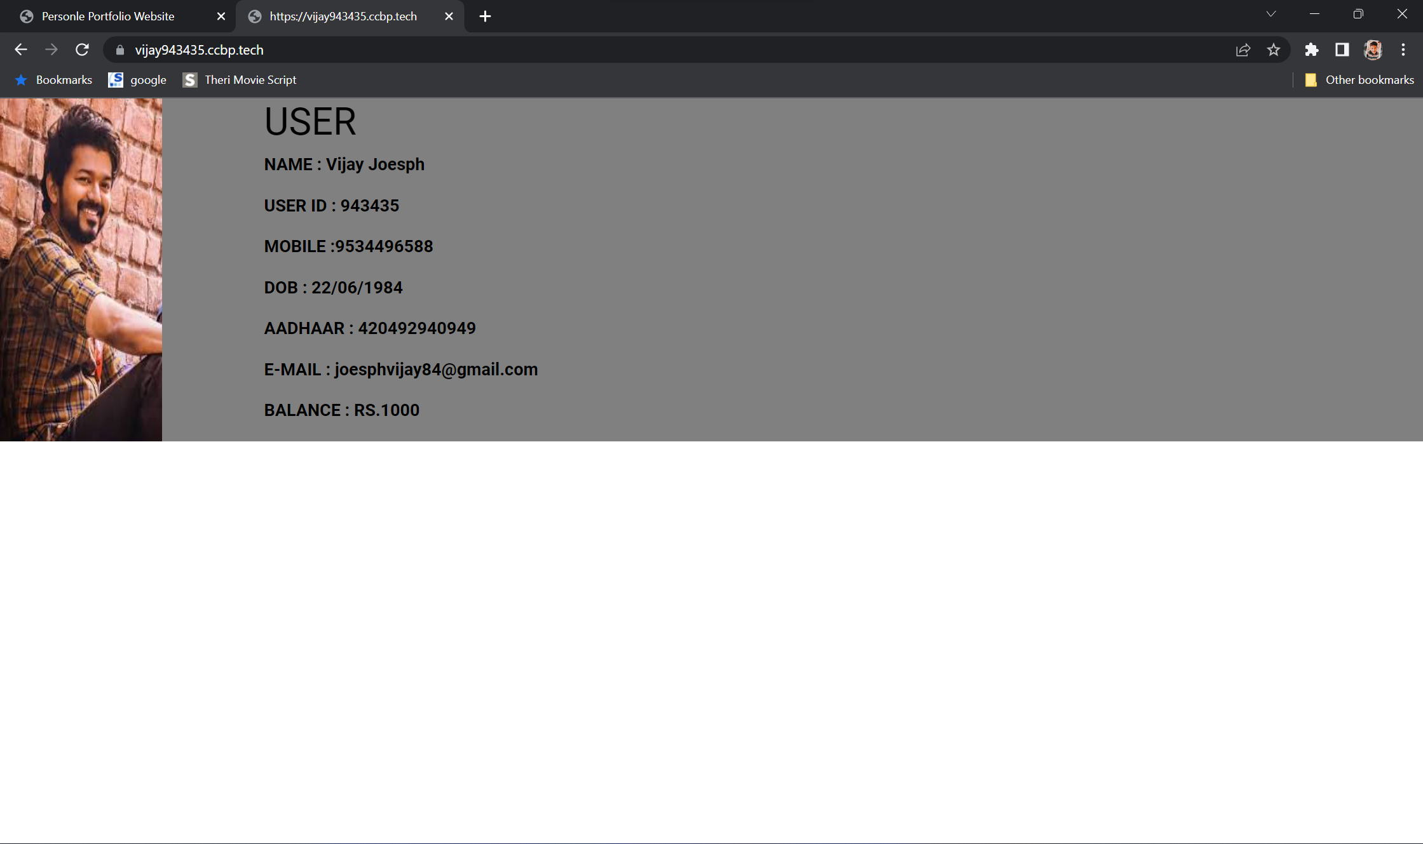

Slide 24
RECHARGE
The passenger should login In the website with his login id and password.
The website will provide the details of passenger and his booking transaction details
This will have a recharge option so by clicking it that will show many DIGITAL payment option gpay, phonepe or through debit/credit card
we can recharge the card by means of direct payment method also in postal office

Slide 25
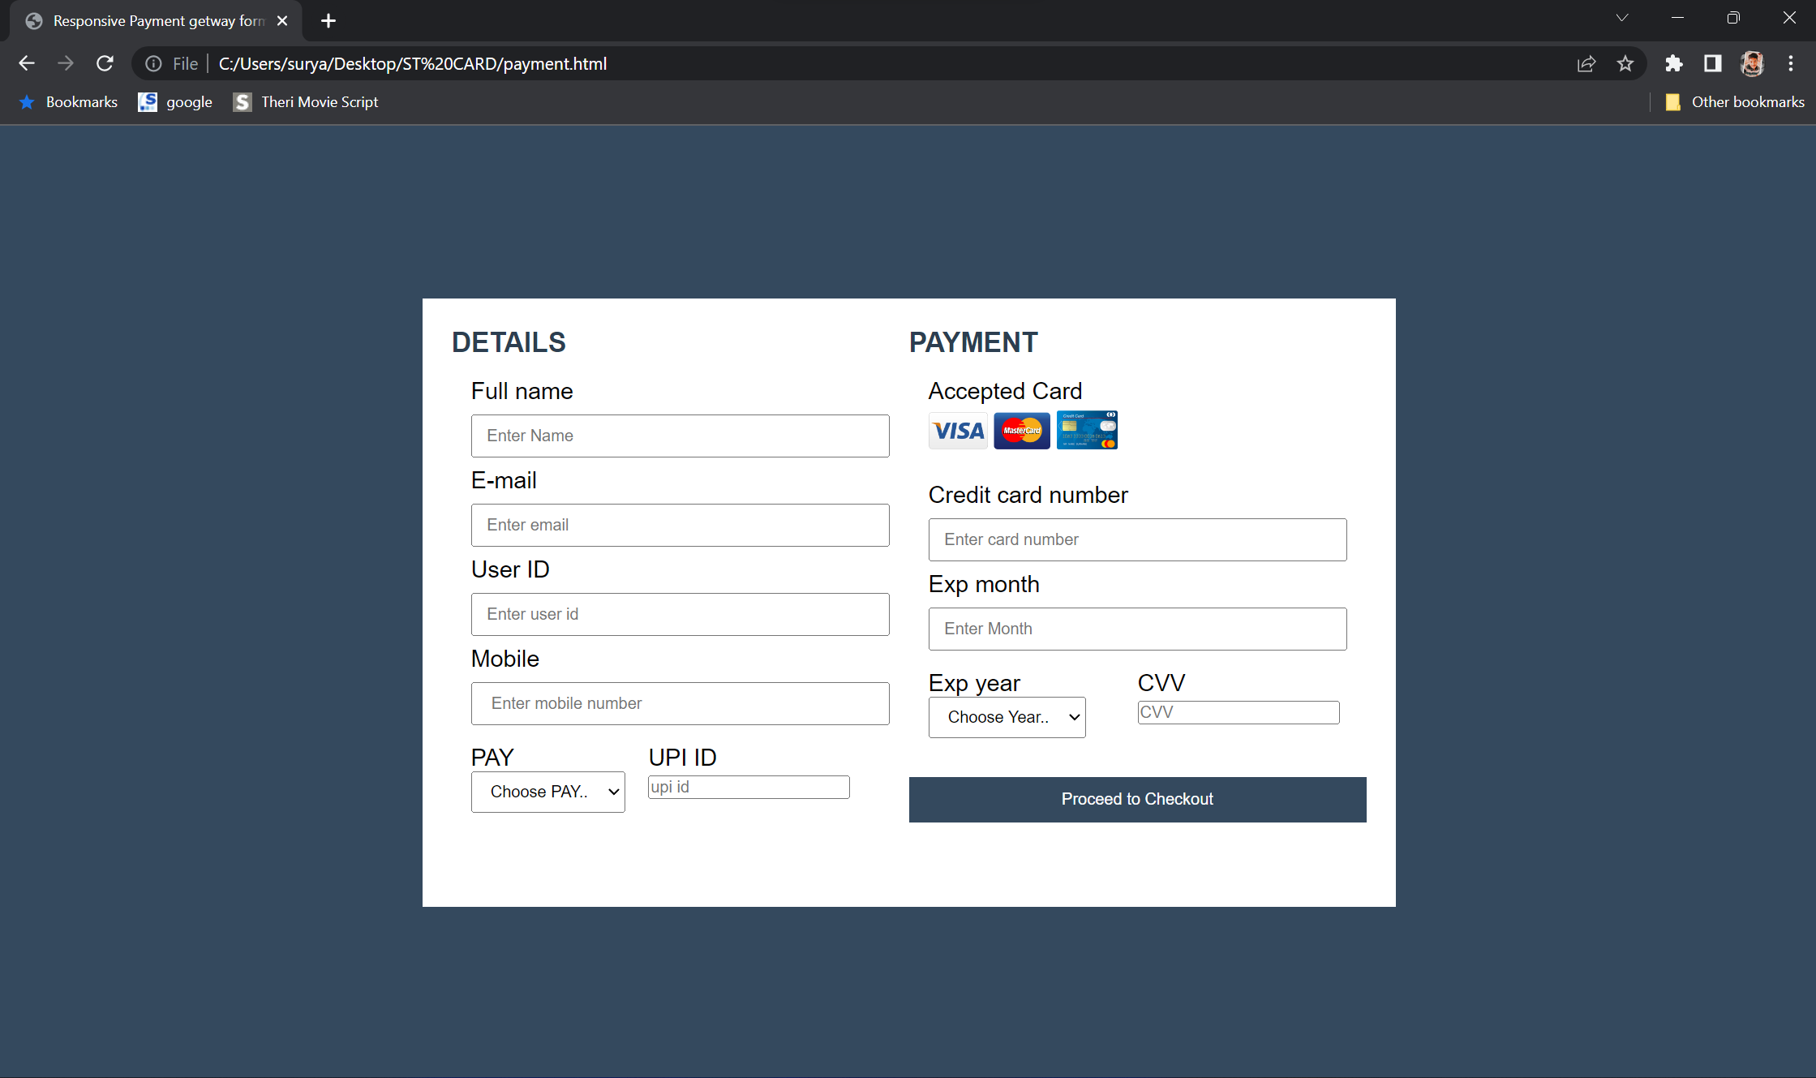

Slide 26


Slide 27
THANKING YOU
TEAM: WANDERERS

